Slide 1
ISE 2025 Quality Award
Jinhong Brejnholt
Saxo Bank
6th Feb

Slide 2



About Saxo Bank
Online trading and investment
17 billion USD daily trade
200+ banks and brokers
1.2 million clients
DKK 816 billion in client assets
jbrejnholt
Notes:
Saxo Bank is a Danish investment bank specializing in online trading and investment. It was founded as a brokerage firm in 1992, under the name Midas Fondsmæglerselskab, by Lars Seier Christensen, Kim Fournais, and Marc Hauschildt. The name was changed to Saxo when the company obtained a banking license in 2001.
Saxo Bank A/S is a fully licensed and regulated Danish bank with an online trading platform that empowers you to invest across global financial markets.

Slide 3
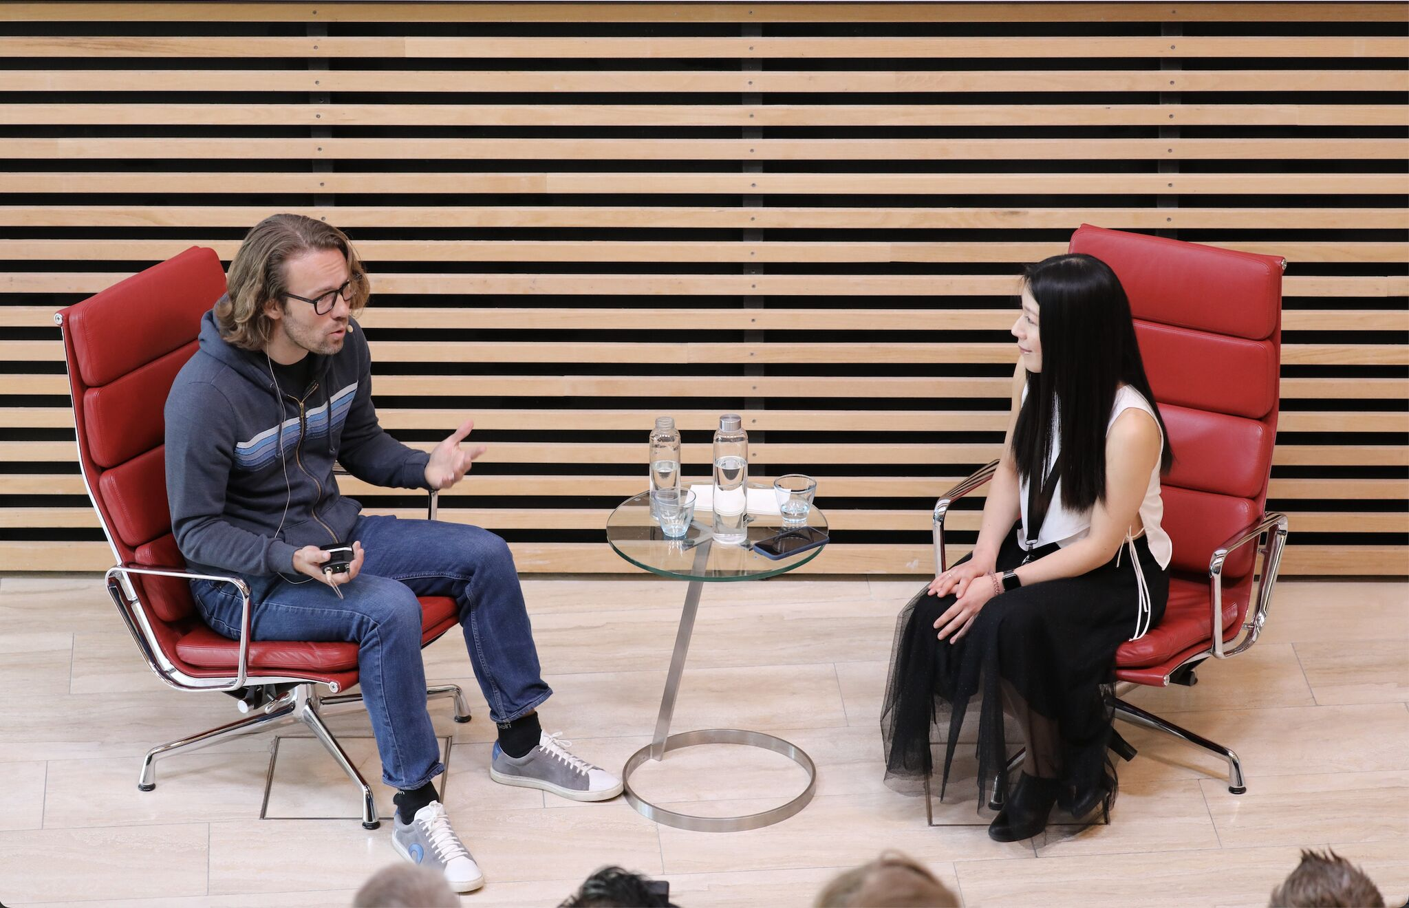
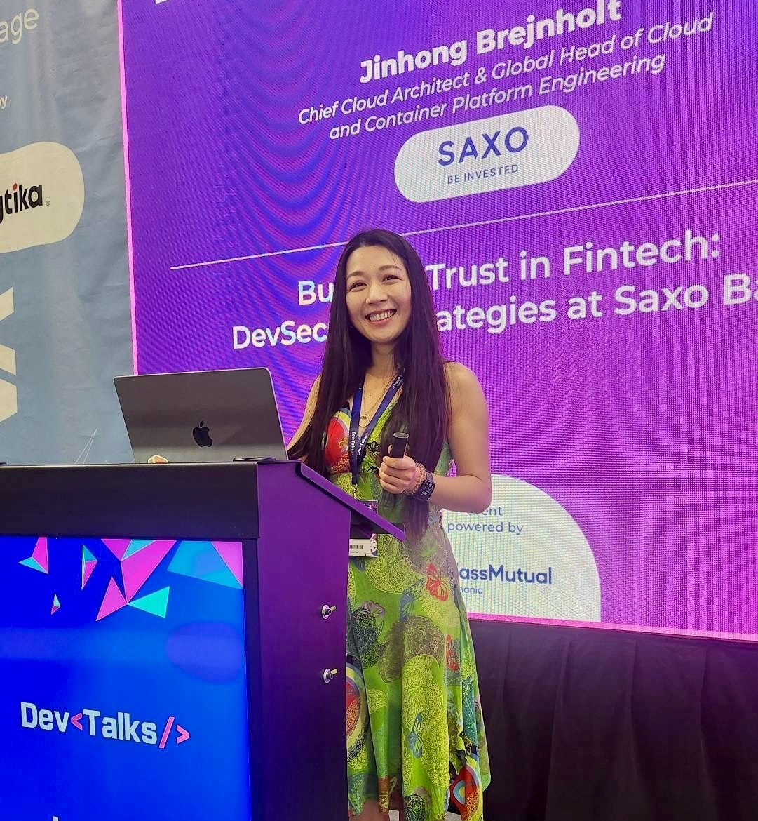
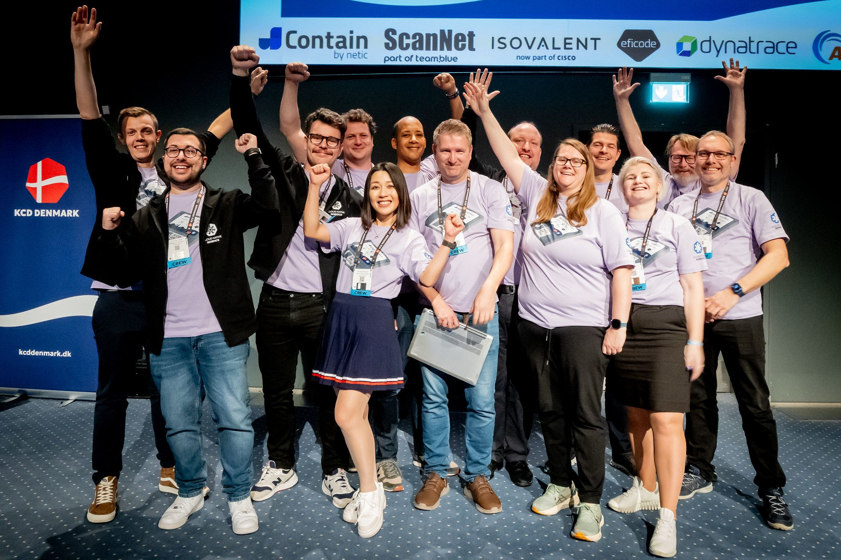
whoami
jbrejnholt

Slide 4


jbrejnholt
Notes:
Why sponsoring ISE

Slide 5

jbrejnholt
Notes:
Importance of supporting education and fostering future talent
our commitment to innovation and excellence in field of software engineering

Slide 6

What are the criteria?
jbrejnholt
Notes:
Now the question to you - how is your cloud journey?

Slide 7

Four Winning Criteria
Take Ownership
Pursue Win-Win Outcomes
Presentation Technique
Teamwork
jbrejnholt

Slide 8

Take Ownership
Collabration with the company
Integration with existing Ways of Working
jbrejnholt
Notes:
Engagement with the company
Adapting and enhacing current practices through scrum methodologies

Slide 9

Pursue Win-Win Outcomes
Application of what you learn
Creation of corporate value
jbrejnholt
Notes:
Applying course knowledge to practical scenarios
Delivering tangible benefits to the company

Slide 10

Presentation Technique
Effective Presentation and Pitching
Responsive Engagement
jbrejnholt
Notes:
Articulating ideas clearly and persuasively
Thoughtful and confident responses to questions and feedback

Slide 11

Teamwork
Embrace Difference
Utilization of Team Potential
jbrejnholt
Notes:
Valuing diversa skills and perspectives
Leveraging stengths of each team members

Slide 12

Take Ownership
Pursue Win-Win Outcomes
Presentation Technique
Teamwork
jbrejnholt

Slide 13

jbrejnholt

